Slide 1
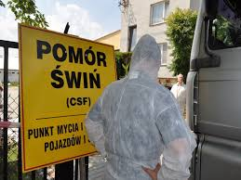
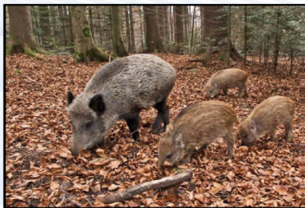
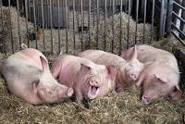
ASF Problem
http://belik.userpage.fu-berlin.de/files/asf_map.html
Recent rapid spread of the African Swine Fever (ASF) in the Northeast Poland during summer 2017 encourages me to prepare risk assessment for the whole country and predict future geographical transmission paths.
African swine fever is viral infection which causes acute disease in domestic pigs and wild boar.
Although the virus does not cause disease in humans, the impact it has on the economy, especially through trade and farming, is substantial.
Veterinary epidemiology (epizoology) & emerging disease
Notes:
1

Slide 2


Introduction – 2014
Due to restrictions ~90% (~30000) of farms in affected areas of Poland (June 2017) stopped pig production or were banned
Ban for export of pork to many countries
Reduction of pigs heads from 14 millions in 2013 to 11 millions in 2016
Costs to National Economy >100 millions EUR annually
Consequences of ASF in Poland (only)
Notes:
1

Slide 3
Epidemiology
The disease affects domestic pigs (Sus scrofa domesticus) and Eurasian wild boars (Sus scrofa ferus) as well as feral pigs
Acute (animals die before producing antibodies) /subacute (animals die before showing specific clinical symptoms) forms
No neutralizing antibodies
No vaccine
No treatment
Notes:
1

Slide 4
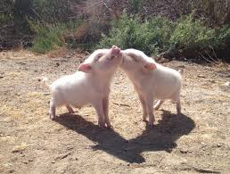
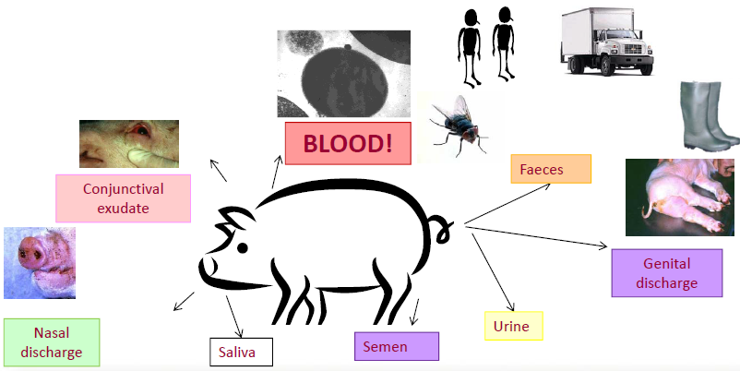
Infectious materials:
blood
nosal swabs
rectal swabs
vaginal
Routes:
S as Swine and WB as Wild Boar both nose-nose and S airborne/droplet in farm
Feeding on carcases (S, but WB are not showing cannibalism in normal situation)
Meat rest-overs and faecal-oral (S-WB via human and S-S via human)
Formites and contaminated environment (S directly of indirectly via human)
Pork supply chain (S-S via human)
Aetiology
Notes:
1

Slide 5
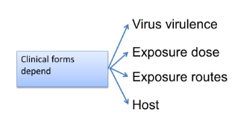
Pathogenesis
African swine fever (ASF) is one of the most complex diseases affecting livestock.
Viremia
Exposure
or ?Infection
Transmission
Dynamics
Clinical
signs
Death
0-2
days
1-3
days
2-13 days
Susceptible
S
Exposed
E
Infectious
I
Death/Detection
D
Less than 1-2% WB can survive
Notes:
1

Slide 6

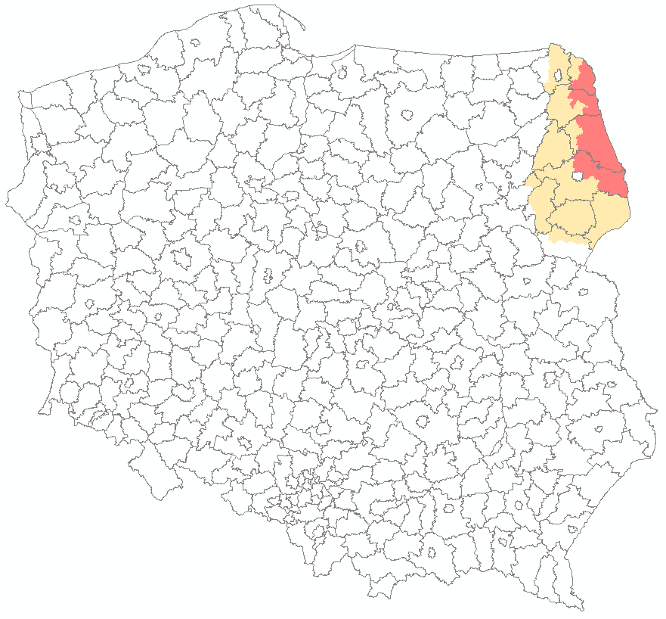

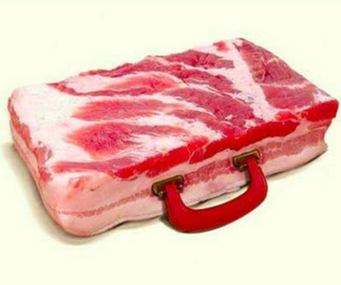



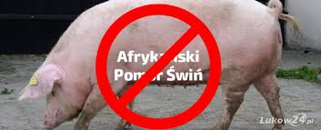
Anthropic Risk
Notes:
1

Slide 7
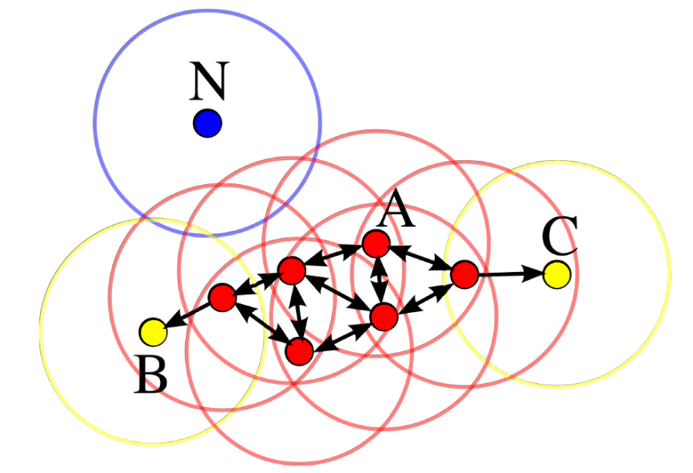
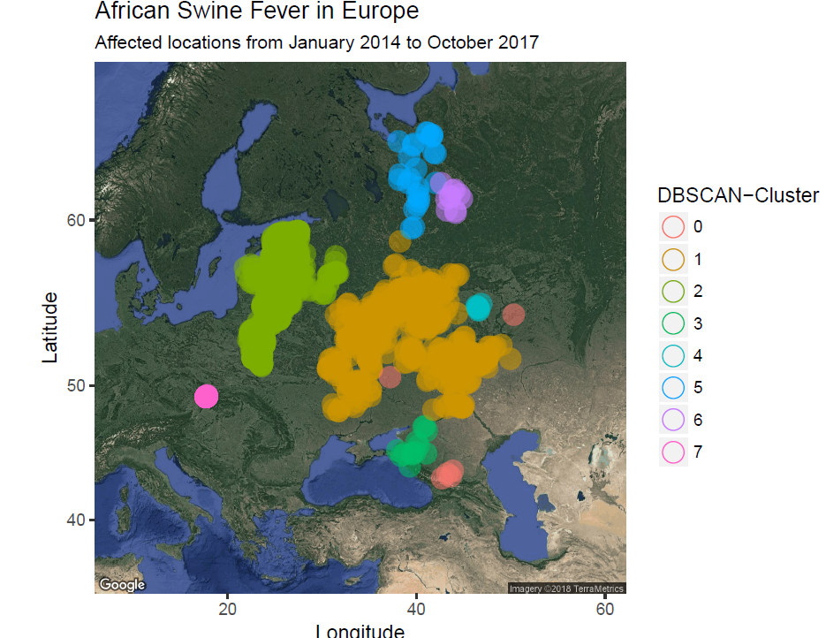
Density-based spatial clustering of applications with noise (DBSCAN)
Spatial –temporal spread
Notes:
1

Slide 8





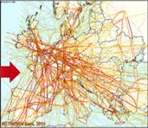
Short and Long distance interactions
No additional links
With additional links
Pigs movement
Flights network
Notes:
1

Slide 9
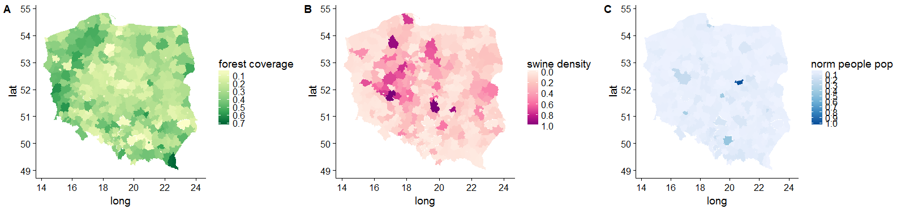
Inferring Data
Forest density
Swine population
Human population
Regression models
Dependent variables: explained variable is 0/1 (infected/not infected county);explained variable is integer (number of events understood as sum of outbreaks and cases in county); explained variable is time (arrival time of ASF for given county).
Explaining variables: heads of pigs, coverage of forests, human population
The most important conclusion form regressions is, that pig heads strongly explain both probability of introducing ASF as well as epidemic size (which is in contradiction to Estonian study (Depner, et al. 2017)). On the other hand, the forest coverage explains a little the arrival time of ASF (the same as in Estonian study (Depner, et al. 2017)).
Notes:
1

Slide 10
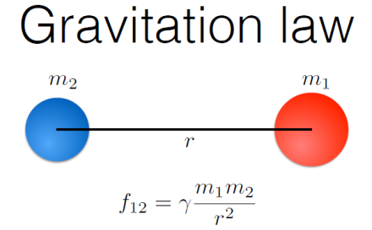
Pseudo Gravity Model
Notes:
1

Slide 11

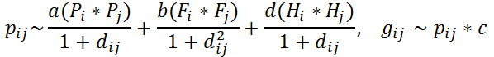

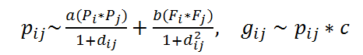
Model – spatial - based propagation
We run set of simulations for selected subspace of parameters a- swine amount significance, b- disease vectors (wild boars) significance, c- pork production chain significance.
Where: a, b, c, d – simulation parameters; i, j – poviats; P – normalized amount of pigs; F – coverage of forests; p_{ij} -probability of infection from a neighbor; g_{ij} -probability of infection from a whole networks; d_{ij} -angular distance between centroids of poviats (counties).
Notes:
1

Slide 12
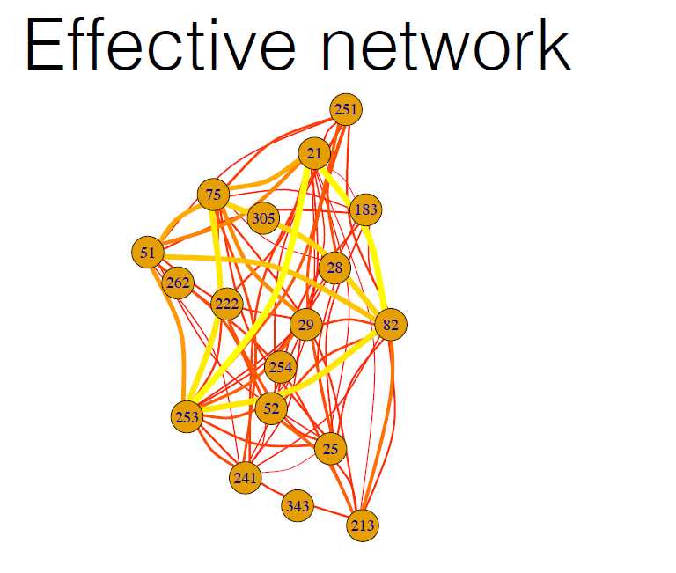
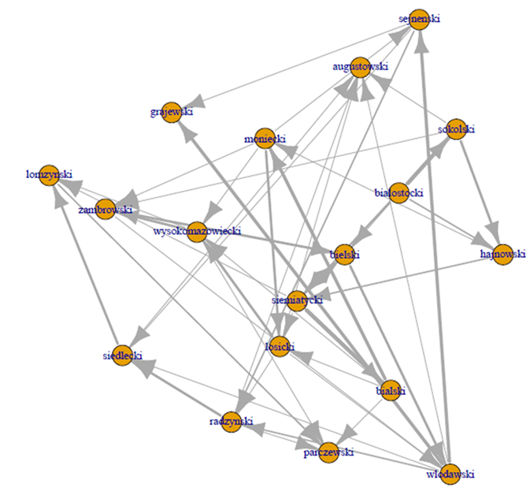
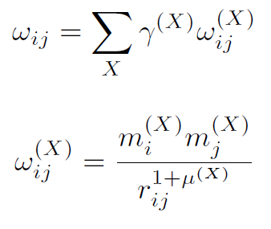
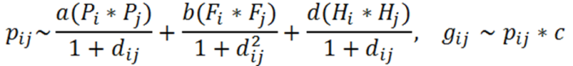
Model – spatial - based propagation
Simulations
Notes:
1

Slide 13

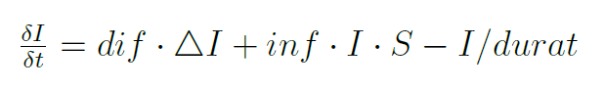
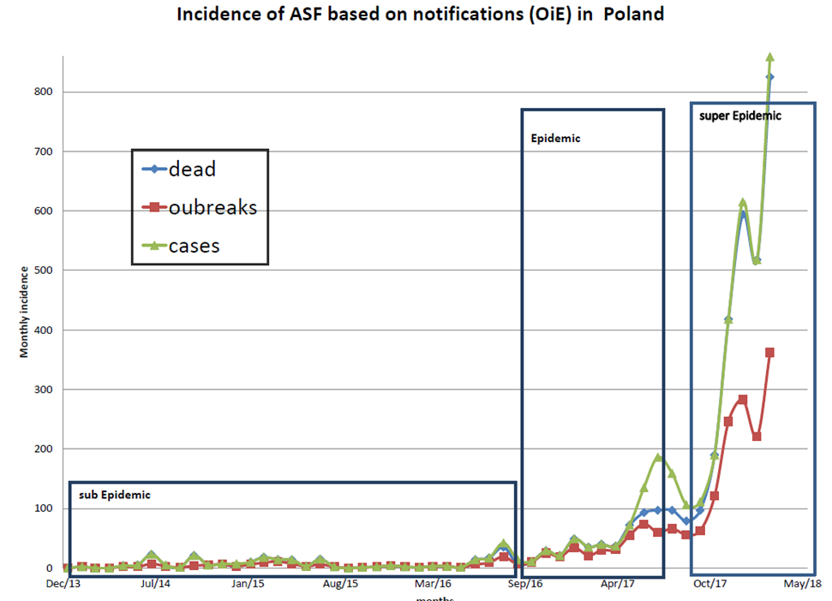
Model – spatial propagation
Partial differential equations in the geographic spread of diseases to describe the time evolution of the epidemic, but also of the transfer of the disease to new areas. For example, by slightly modifying the infecting equation to express the diffusion (where Δ is the Laplacian, and dif is the diffusion coefficient), we obtain:
According to simplified relation in SIF (Susceptible, Infectious, Free) model R₀=inf*durat we observe that detection and elimination time is critical to satisfy epidemic condition (R₀=1).
1) Regime February 2014 to July 2016. Pre (sub) epidemic regime, spatial expansion ~0.28 County per month. Infectivity rate is estimated between 0 up to 0.005 with reasonable upper limit around on 0 level per month
2) Regime July 2016 to June 2017 – stationary ‘epidemic’ regime with increase due to spatial expansion ~0.8/4.4% monthly County per month. Infectivity rate is estimated between 0.2 up to 1.25 with reasonable guess around 0.25 per month
3) Regime June 2017 till March 2018 –super epidemic regime with nonstationary outbreak (faster increase due and WB hunting surveillance, spatial expansion ~0.75 County per month/3.2% monthly). Infectivity rate is estimated between 0.25 up to 5 with reasonable guess around 0.27 per month
Notes:
1

Slide 14
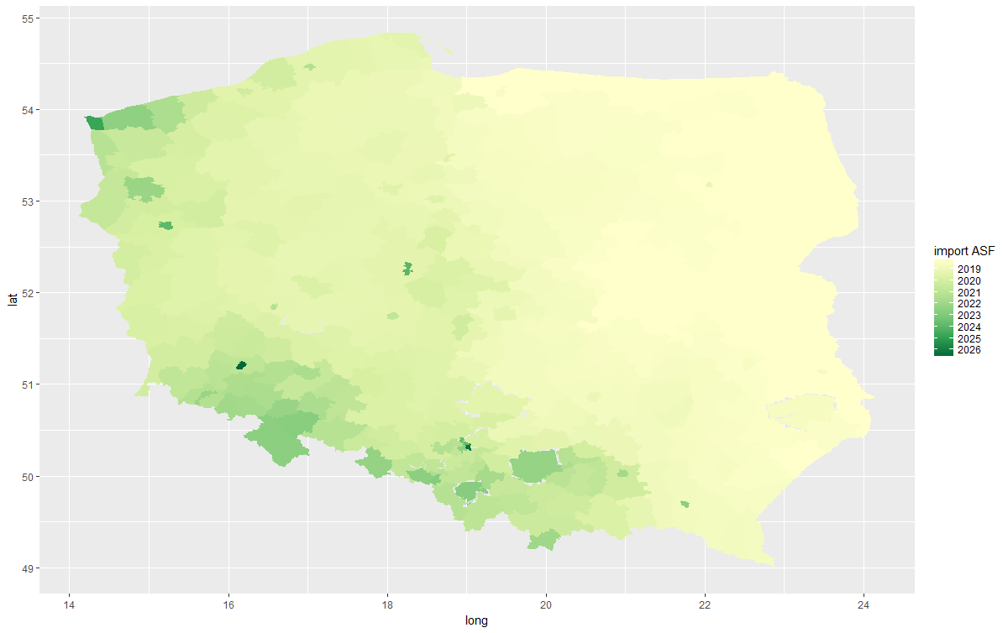
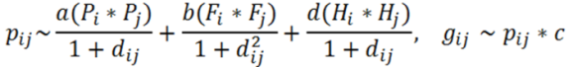

Most likely introduction time (in weeks) according to the model with possible corridors.
Model – spatial propagation

Notes:
1

Slide 15
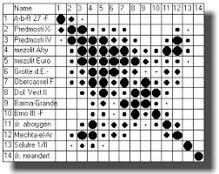
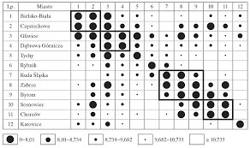
Wroclaw taxonomy
Florek K., Łukaszewicz J., Perkal J., Steinhaus H., Zubrzycki S. (1931); Sur le liaison et la decision des points d’un ensemble fini, Colloqium Mathematicum, t. II, nr 3-4, Lviv
Guenther-Swart, Imma von. (1941) Grundlagen der Landwirtschaft im Reichsgau Wartheland und im Reichsgau Danzig-Westpreussen. S Hirzel, Leipzig
Notes:
1

Slide 16
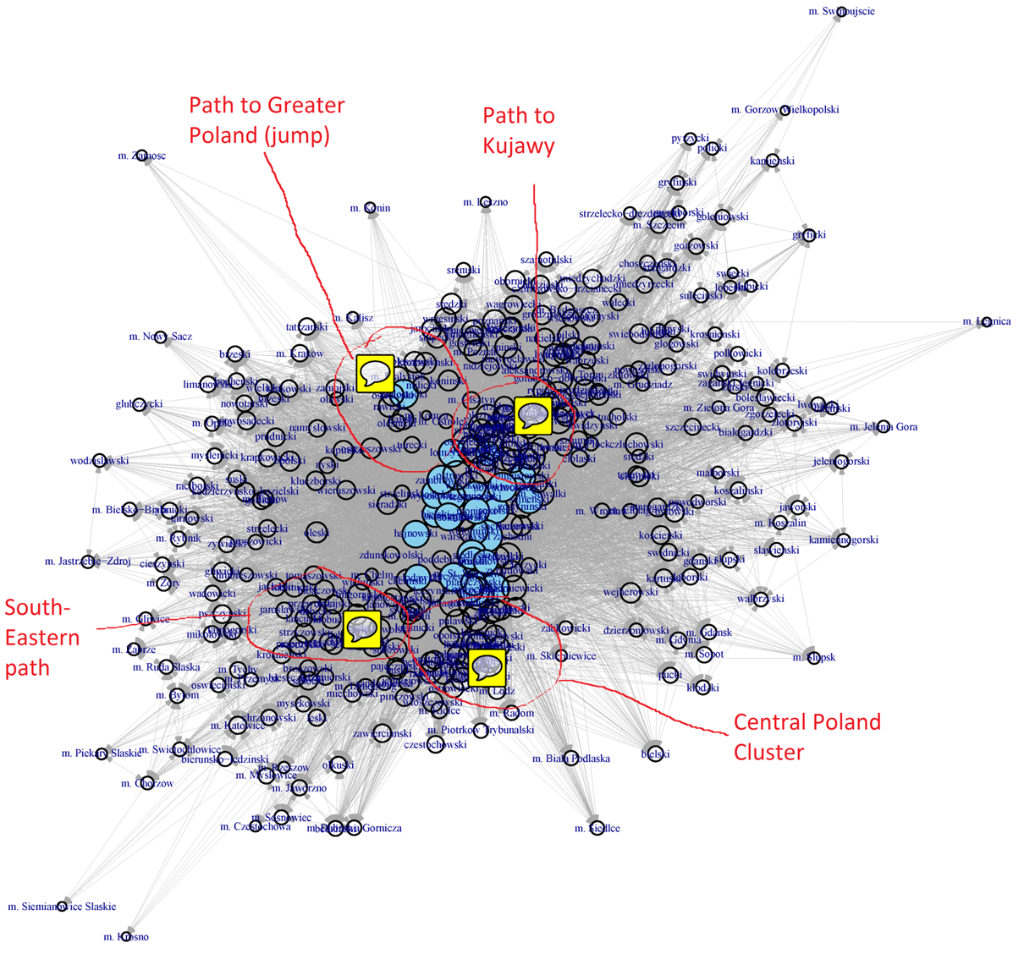
Most likely transmission paths according to the model. High betweenness centrality of Greater Poland counties and high clusterization of Kujawy/Masovia region could indicate the most important prevention directions.
Spatial - based propagation
Notes:
1

Slide 17
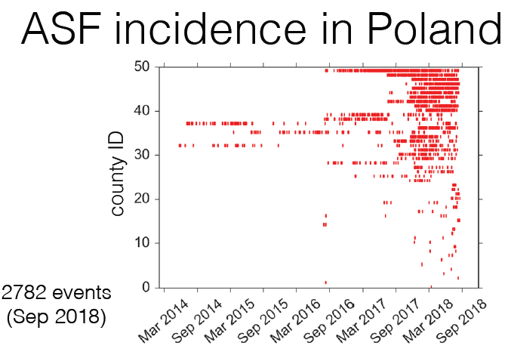
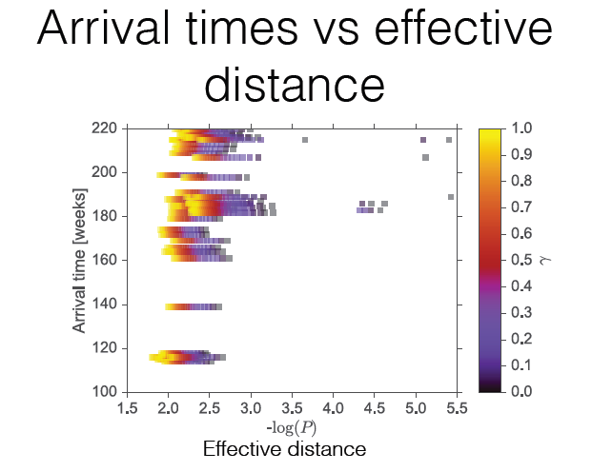
Epidemiology
Notes:
1

